Slide 1
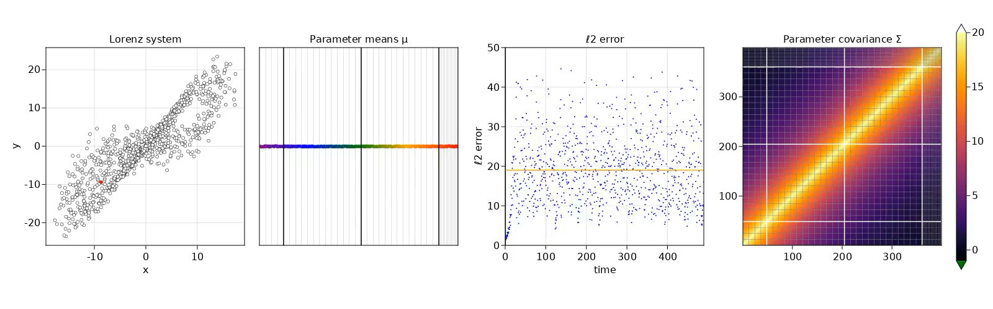
Uncertainty Quantification in Neural Networks
Andrew Arnold
Natalie Klein & Casey Gibson
Monday, July 10, 2023
Notes:
Presentation Title Slide Notes
“UNCLASSIFIED” marking of slides is not a security requirement and may be deleted from the Slide Master (View › Master › Slide Master). In general, slides should be marked “UNCLASSIFIED” if there is potential for confusion or misinterpretation of something that could be deemed classified. For guidance on marking slides containing classified and unclassified controlled information, see the Protecting Information Web site at http://int.lanl.gov/security/protectinfo/.

Slide 2
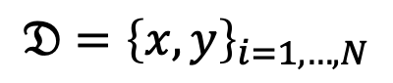
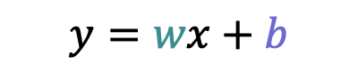
Preliminary: Bayesian Linear Regression
Data
$$𝔇={\left\{x,y\right\}}_{i=1,…,N}$$
Model
$$y=wx+b$$
See: https://gregorygundersen.com/blog/2020/02/04/bayesian-linear-regression/
Notes:
Data, want to fit a model.

Slide 3
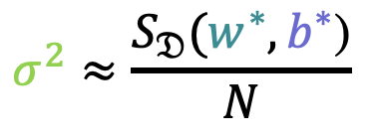
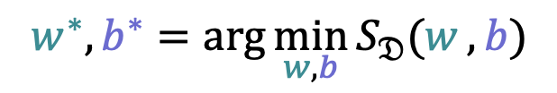
Preliminary: Bayesian Linear Regression
Data
$$𝔇={\left\{x,y\right\}}_{i=1,…,N}$$
Model
$$y=wx+b$$
Ordinary Least Squares:
$$w^{∗},b^{∗}=\arg{\min_{w,b}{S_{𝔇}(w},b})$$
$$σ^{2}≈\frac{S_{𝔇}(w^{∗},b^{∗}\text{)}}{N}$$
See: https://gregorygundersen.com/blog/2020/02/04/bayesian-linear-regression/
Notes:
Frequentist approach, minimize least squares. Variance estimated in the frequentist way.

Slide 4
Preliminary: Bayesian Linear Regression
Data
$$𝔇={\left\{x,y\right\}}_{i=1,…,N}$$
Model
$$y=wx+b$$
Bayes
$$p\left(w,b,σ^{2}|𝔇\right)∝ ℒ\left(𝔇|w,b,σ^{2}\right)∙p\left(w,b,σ^{2}\right)$$
See: https://gregorygundersen.com/blog/2020/02/04/bayesian-linear-regression/
Notes:
Bayesian Alternative

Slide 5
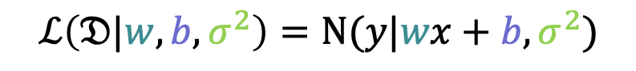
Preliminary: Bayesian Linear Regression
Data
$$𝔇={\left\{x,y\right\}}_{i=1,…,N}$$
Model
$$y=wx+b$$
Bayes
$$p\left(w,b,σ^{2}|𝔇\right)∝ ℒ\left(𝔇|w,b,σ^{2}\right)∙p\left(w,b,σ^{2}\right)$$
Likelihood
$$ℒ\left(𝔇|w,b,σ^{2}\right)=Ν(y|wx+b,σ^{2})$$
See: https://gregorygundersen.com/blog/2020/02/04/bayesian-linear-regression/
Notes:
Likelihood corresponds with ordinary least squares: Maximum likelihood estimate

Slide 6
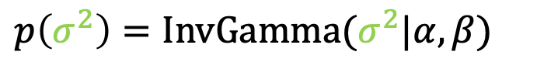
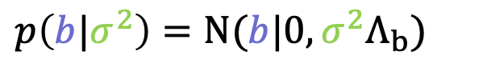
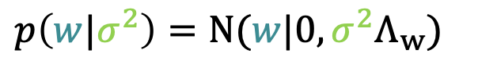
Preliminary: Bayesian Linear Regression
Data
$$𝔇={\left\{x,y\right\}}_{i=1,…,N}$$
Model
$$y=wx+b$$
Bayes
$$p\left(w,b,σ^{2}|𝔇\right)∝ ℒ\left(𝔇|w,b,σ^{2}\right)∙p\left(w,b,σ^{2}\right)$$
Likelihood
$$ℒ\left(𝔇|w,b,σ^{2}\right)=Ν(y|wx+b,σ^{2})$$
$$p\left(w|σ^{2}\right)=Ν(w|0,σ^{2}Λ_{w})$$
Priors
$$p\left(b|σ^{2}\right)=Ν(b|0,σ^{2}Λ_{b})$$
$$p\left(σ^{2}\right)=InvGamma(σ^{2}|α,β)$$
See: https://gregorygundersen.com/blog/2020/02/04/bayesian-linear-regression/
Notes:
Have to choose some priors, so we pick priors that make our life easy

Slide 7
Preliminary: Bayesian Linear Regression
Data
$$𝔇={\left\{x,y\right\}}_{i=1,…,N}$$
Model
$$y=wx+b$$
Bayes
$$p\left(w,b,σ^{2}|𝔇\right)∝ ℒ\left(𝔇|w,b,σ^{2}\right)∙p\left(w,b,σ^{2}\right)$$
Likelihood
Insert animation of function space training
$$ℒ\left(𝔇|w,b,σ^{2}\right)=Ν(y|wx+b,σ^{2})$$
$$p\left(w|σ^{2}\right)=Ν(w|0,σ^{2}Λ_{w})$$
Priors
$$p\left(b|σ^{2}\right)=Ν(b|0,σ^{2}Λ_{b})$$
$$p\left(σ^{2}\right)=InvGamma(σ^{2}|α,β)$$
See: https://gregorygundersen.com/blog/2020/02/04/bayesian-linear-regression/
Notes:
We get a distribution out: quantified epistemic uncertainty, not just sigma (aleatoric uncertainty)

Slide 8
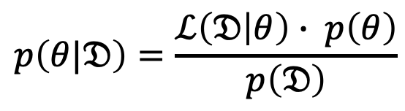
UQ: Bayesian Neural Networks
$$p\left(θ|𝔇\right)=\frac{ℒ\left(𝔇 | θ\right)∙ p\left(θ\right)}{p\left(𝔇\right)}$$
BNN:
Notes:
Local minima correspond to modes of
If No Regularization, we can treat last term as a constant—uniform priors

Slide 9
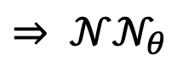

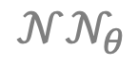
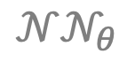

UQ: Bayesian Neural Networks
$$p\left(θ|𝔇\right)=\frac{ℒ\left(𝔇 | θ\right)∙ p\left(θ\right)}{p\left(𝔇\right)}$$
$$𝒩𝒩_{θ}$$
$$𝒩𝒩_{θ}$$
BNN:
$$⇒ 𝒩𝒩_{θ}$$
$$𝒩𝒩_{θ}$$
$$𝒩𝒩_{θ}$$
Notes:
Local minima correspond to modes of
If No Regularization, we can treat last term as a constant—uniform priors

Slide 10
UQ: Bayesian Neural Networks
$$p\left(θ|𝔇\right)=\frac{ℒ\left(𝔇 | θ\right)∙ p\left(θ\right)}{p\left(𝔇\right)}$$
$$𝒩𝒩_{θ}$$
$$𝒩𝒩_{θ}$$
BNN:
$$⇒ 𝒩𝒩_{θ}$$
$$𝒩𝒩_{θ}$$
$$𝒩𝒩_{θ}$$
-log(□)
exp(-□)
DNN:
$θ^{∗}=\arg{\min_{θ}{(−\log{ℒ\left(𝔇 | θ\right)−\log{p\left(θ\right)}}+\log{p(𝔇}))}}$
Notes:
Local minima correspond to modes of
If No Regularization, we can treat last term as a constant—uniform priors

Slide 11
UQ: Bayesian Neural Networks
$$p\left(θ|𝔇\right)=\frac{ℒ\left(𝔇 | θ\right)∙ p\left(θ\right)}{p\left(𝔇\right)}$$
$$𝒩𝒩_{θ}$$
$$𝒩𝒩_{θ}$$
BNN:
$$⇒ 𝒩𝒩_{θ}$$
$$𝒩𝒩_{θ}$$
$$𝒩𝒩_{θ}$$
-log(□)
exp(-□)
constant
DNN:
$θ^{∗}=\arg{\min_{θ}{(−\log{ℒ\left(𝔇 | θ\right)−\log{p\left(θ\right)}}+\log{p(𝔇}))}}$
Notes:
Local minima correspond to modes of
If No Regularization, we can treat last term as a constant—uniform priors

Slide 12
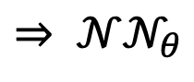
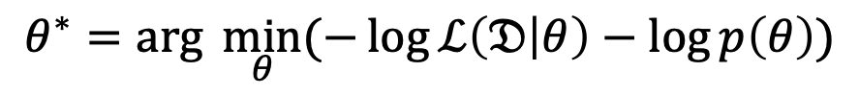
UQ: Bayesian Neural Networks
$$p\left(θ|𝔇\right)=\frac{ℒ\left(𝔇 | θ\right)∙ p\left(θ\right)}{p\left(𝔇\right)}$$
$$𝒩𝒩_{θ}$$
$$𝒩𝒩_{θ}$$
BNN:
$$⇒ 𝒩𝒩_{θ}$$
$$𝒩𝒩_{θ}$$
$$𝒩𝒩_{θ}$$
-log(□)
exp(-□)
DNN:
$θ^{∗}=\arg{\min_{θ}{(−\log{ℒ\left(𝔇 | θ\right)−\log{p\left(θ\right)}})}}$
$$⇒ 𝒩𝒩_{θ}$$
Notes:
Local minima correspond to modes of posterior
If No Regularization, we can treat last term as a constant—uniform priors

Slide 13
UQ: Bayesian Neural Networks
$$p\left(θ|𝔇\right)=\frac{ℒ\left(𝔇 | θ\right)∙ p\left(θ\right)}{p\left(𝔇\right)}$$
$$𝒩𝒩_{θ}$$
$$𝒩𝒩_{θ}$$
BNN:
$$⇒ 𝒩𝒩_{θ}$$
$$𝒩𝒩_{θ}$$
$$𝒩𝒩_{θ}$$
-log(□)
exp(-□)
DNN:
$θ^{∗}=\arg{\min_{θ}{(−\log{ℒ\left(𝔇 | θ\right)−\log{p\left(θ\right)}})}}$
$$⇒ 𝒩𝒩_{θ}$$
Loss
Regularization
Notes:
Local minima correspond to modes of
If No Regularization, we can treat last term as a constant—uniform priors

Slide 14
UQ: Bayesian Neural Networks
$$p\left(θ|𝔇\right)=\frac{ℒ\left(𝔇 | θ\right)∙ p\left(θ\right)}{p\left(𝔇\right)}$$
$$𝒩𝒩_{θ}$$
$$𝒩𝒩_{θ}$$
BNN:
$$⇒ 𝒩𝒩_{θ}$$
$$𝒩𝒩_{θ}$$
$$𝒩𝒩_{θ}$$
-log(□)
exp(-□)
DNN:
$θ^{∗}=\arg{\min_{θ}{(−\log{ℒ\left(𝔇 | θ\right)−\log{p\left(θ\right)}})}}$
$$⇒ 𝒩𝒩_{θ}$$
Loss
Regularization
Prior | Regularization
Normal | L2 (Mean squared error)
Laplace | L1 (LASSO)
Horseshoe | ???
Notes:
Local minima correspond to modes of
If No Regularization, we can treat last term as a constant—uniform priors

Slide 15
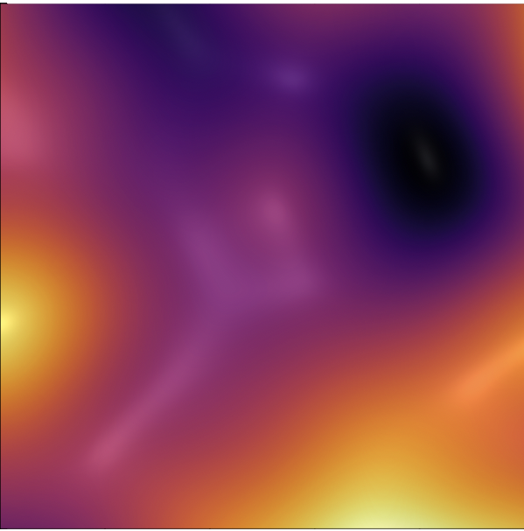
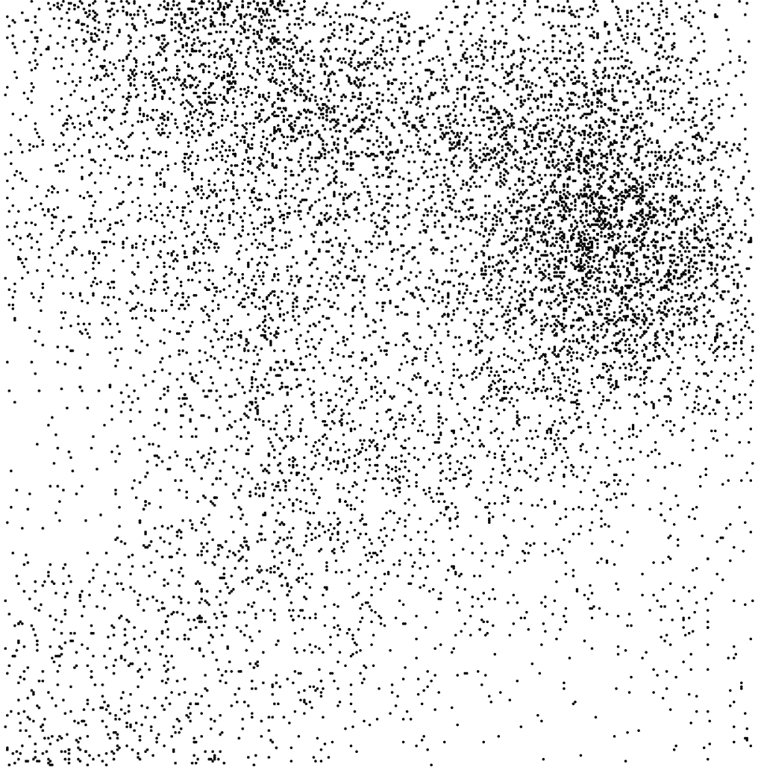
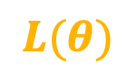
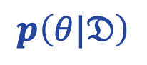
UQ: Bayesian Neural Networks
$$p\left(θ|𝔇\right)=\frac{ℒ\left(𝔇 | θ\right)∙ p\left(θ\right)}{p\left(𝔇\right)}$$
$$𝒩𝒩_{θ}$$
$$𝒩𝒩_{θ}$$
BNN:
$$⇒ 𝒩𝒩_{θ}$$
$$𝒩𝒩_{θ}$$
$$𝒩𝒩_{θ}$$
-log(□)
exp(-□)
DNN:
$θ^{∗}=\arg{\min_{θ}{(−\log{ℒ\left(𝔇 | θ\right)−\log{p\left(θ\right)}})}}$
$$⇒ 𝒩𝒩_{θ}$$
Loss
Regularization
$$L(θ)$$
$$p\left(θ|𝔇\right)$$
Notes:
Local minima correspond to modes of
If No Regularization, we can treat last term as a constant—uniform priors

Slide 16
UQ: Bayesian Neural Networks
$$p\left(θ|𝔇\right)=\frac{ℒ\left(𝔇 | θ\right)∙ p\left(θ\right)}{p\left(𝔇\right)}$$
$$𝒩𝒩_{θ}$$
$$𝒩𝒩_{θ}$$
BNN:
$$⇒ 𝒩𝒩_{θ}$$
$$𝒩𝒩_{θ}$$
$$𝒩𝒩_{θ}$$
Perform inference to obtain posterior of $𝒩𝒩$ parameters $θ$.
How?
Notes:
Local minima correspond to modes of
If No Regularization, we can treat last term as a constant—uniform priors

Slide 17
UQ: Bayesian Neural Networks
$$p\left(θ|𝔇\right)=\frac{ℒ\left(𝔇 | θ\right)∙ p\left(θ\right)}{p\left(𝔇\right)}$$
$$𝒩𝒩_{θ}$$
$$𝒩𝒩_{θ}$$
BNN:
$$⇒ 𝒩𝒩_{θ}$$
$$𝒩𝒩_{θ}$$
$$𝒩𝒩_{θ}$$
Perform inference to obtain posterior of $𝒩𝒩$ parameters $θ$.
How?
Variational Inference
Markov Chain Monte Carlo
+ Cheaper
- Expensive!
or
- Less expressive
+ Non-parametric
Notes:
Local minima correspond to modes of
If No Regularization, we can treat last term as a constant—uniform priors

Slide 18
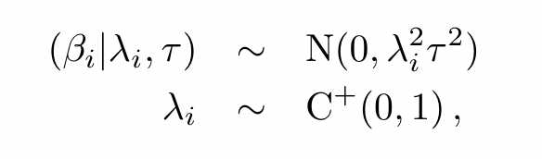
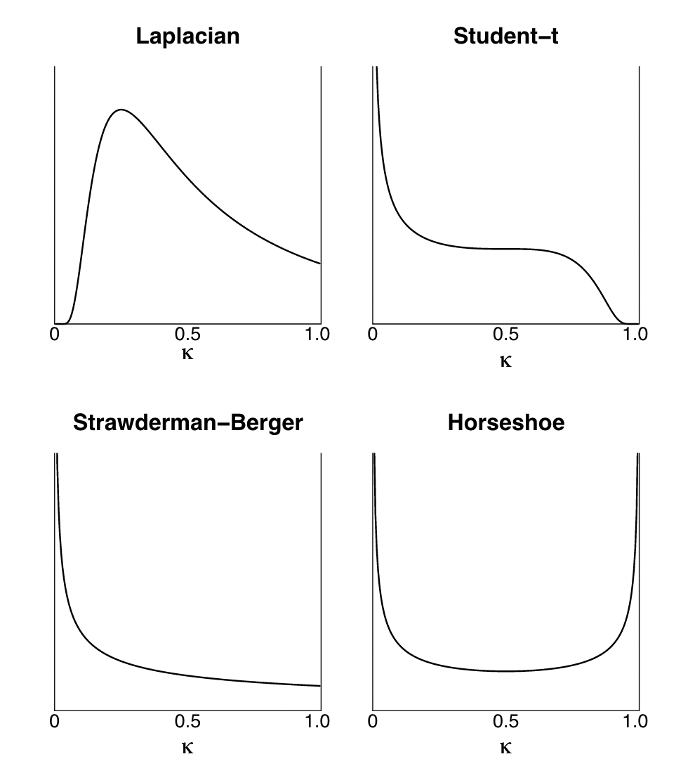
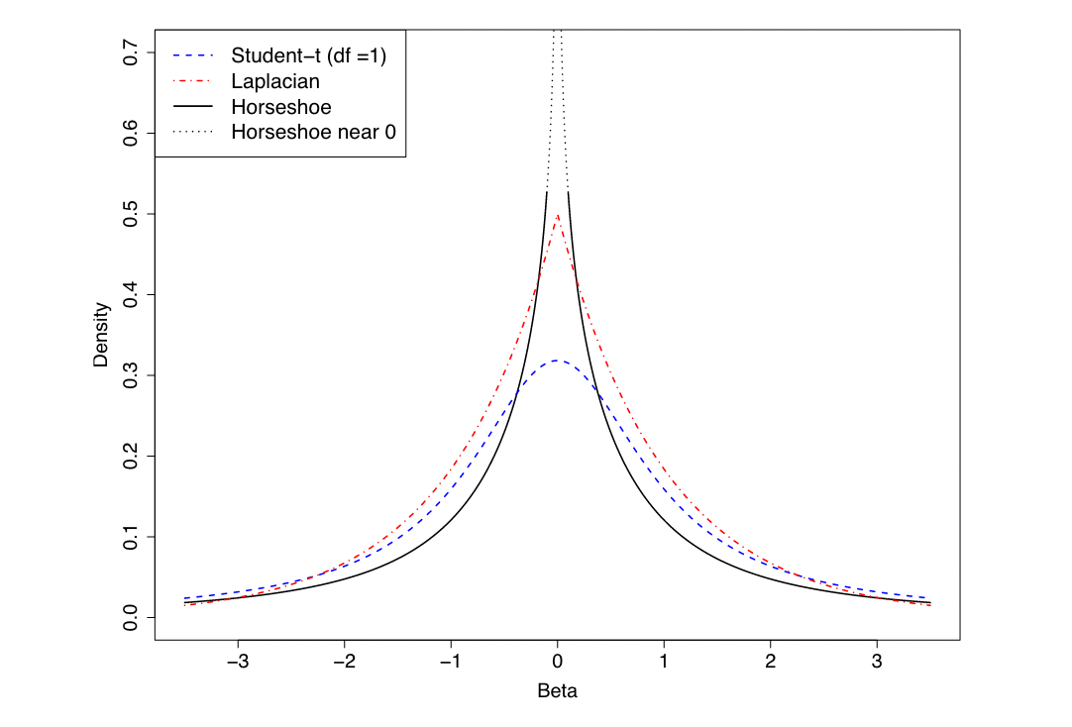
So: What are BNNs good for?
Honesty (for out of distribution)
Horseshoe priors
Regularization
Feature selection
Global characterization
Bayesian learning, including, among others, Laplacian priors (e.g. the LASSO) and Student-t priors (e.g. the relevance vector machine). The advantages of the horseshoe are its robustness at handling unknown sparsity and large outlying signals.
Notes:
Content Slide Notes
“UNCLASSIFIED” marking of slides is not a security requirement and may be deleted from the Slide Master (View › Master › Slide Master). In general, slides should be marked “UNCLASSIFIED” if there is potential for confusion or misinterpretation of something that could be deemed classified. For guidance on marking slides containing classified and unclassified controlled information, see the Protecting Information Web site at http://int.lanl.gov/security/protectinfo/.

Slide 19
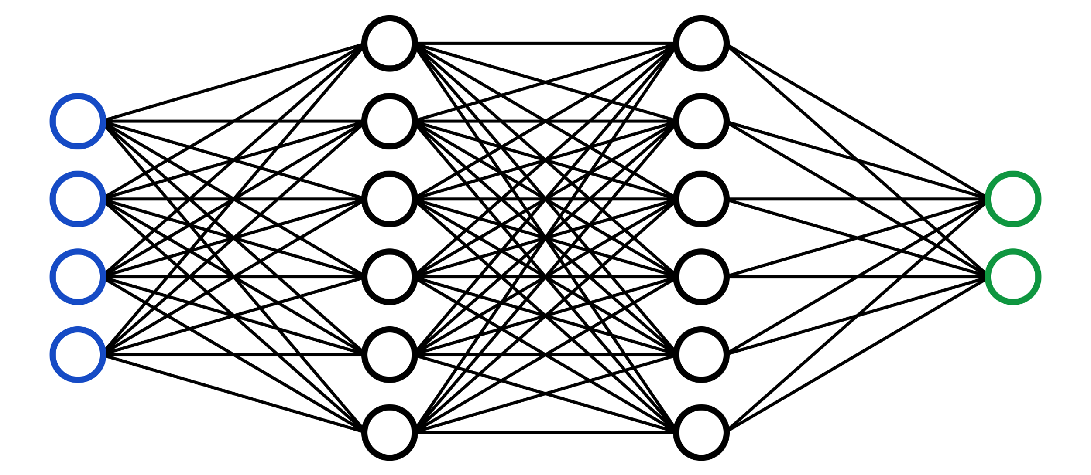
Final Note: Symmetries of NNs
Notes:
Content Slide Notes
“UNCLASSIFIED” marking of slides is not a security requirement and may be deleted from the Slide Master (View › Master › Slide Master). In general, slides should be marked “UNCLASSIFIED” if there is potential for confusion or misinterpretation of something that could be deemed classified. For guidance on marking slides containing classified and unclassified controlled information, see the Protecting Information Web site at http://int.lanl.gov/security/protectinfo/.

Slide 20
Questions?
Notes:
Content Slide Notes
“UNCLASSIFIED” marking of slides is not a security requirement and may be deleted from the Slide Master (View › Master › Slide Master). In general, slides should be marked “UNCLASSIFIED” if there is potential for confusion or misinterpretation of something that could be deemed classified. For guidance on marking slides containing classified and unclassified controlled information, see the Protecting Information Web site at http://int.lanl.gov/security/protectinfo/.

Slide 21
Data Assimilation as Instrumental Uncertainty Quantification
Andrew Arnold
Natalie Klein & Casey Gibson
Monday, July 10, 2023
Notes:
Presentation Title Slide Notes
“UNCLASSIFIED” marking of slides is not a security requirement and may be deleted from the Slide Master (View › Master › Slide Master). In general, slides should be marked “UNCLASSIFIED” if there is potential for confusion or misinterpretation of something that could be deemed classified. For guidance on marking slides containing classified and unclassified controlled information, see the Protecting Information Web site at http://int.lanl.gov/security/protectinfo/.

Slide 22
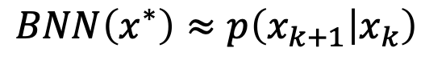
Dynamics in state space
$$BNN\left(x^{∗}\right)≈p\left(x_{k+1} | x_{k}\right)$$
Notes:
Content Slide Notes
“UNCLASSIFIED” marking of slides is not a security requirement and may be deleted from the Slide Master (View › Master › Slide Master). In general, slides should be marked “UNCLASSIFIED” if there is potential for confusion or misinterpretation of something that could be deemed classified. For guidance on marking slides containing classified and unclassified controlled information, see the Protecting Information Web site at http://int.lanl.gov/security/protectinfo/.

Slide 23
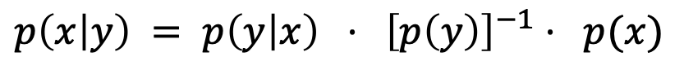
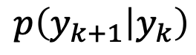
Dynamics in observer space
$$p\left(y_{k+1} | y_{k}\right)$$
There is an alternative to Kalman filtering that does this…
$$p\left(x | y\right) = p\left(y | x\right) {⋅ \left[p\left(y\right)\right]}^{−1} ⋅ p(x)$$
marginalized likelihood
likelihood
prior
Notes:
Content Slide Notes
“UNCLASSIFIED” marking of slides is not a security requirement and may be deleted from the Slide Master (View › Master › Slide Master). In general, slides should be marked “UNCLASSIFIED” if there is potential for confusion or misinterpretation of something that could be deemed classified. For guidance on marking slides containing classified and unclassified controlled information, see the Protecting Information Web site at http://int.lanl.gov/security/protectinfo/.

Slide 24

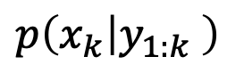
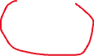
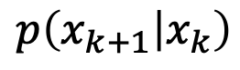
Particle filters
Particle filter operating on state space:
$$p\left(x_{k+1} | x_{k}\right)$$
Particle filter operating on observation space (probably won’t work)
$$p\left(x_{k} | y_{k}\right)p\left(y_{k} | x_{k−1}\right)p\left(x_{k−1} | y_{k−1}\right)⋯$$
$$p\left(x_{k} | y_{1:k} \right)$$
Notes:
Content Slide Notes
“UNCLASSIFIED” marking of slides is not a security requirement and may be deleted from the Slide Master (View › Master › Slide Master). In general, slides should be marked “UNCLASSIFIED” if there is potential for confusion or misinterpretation of something that could be deemed classified. For guidance on marking slides containing classified and unclassified controlled information, see the Protecting Information Web site at http://int.lanl.gov/security/protectinfo/.

Slide 25
Two flavors of priors
Andrew Arnold
Natalie Klein & Casey Gibson
Monday, June 19, 2023
Notes:
Presentation Title Slide Notes
“UNCLASSIFIED” marking of slides is not a security requirement and may be deleted from the Slide Master (View › Master › Slide Master). In general, slides should be marked “UNCLASSIFIED” if there is potential for confusion or misinterpretation of something that could be deemed classified. For guidance on marking slides containing classified and unclassified controlled information, see the Protecting Information Web site at http://int.lanl.gov/security/protectinfo/.

Slide 26
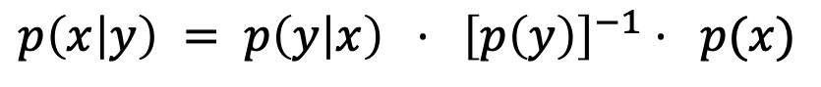
The Art of Picking Priors
$$p\left(x | y\right) = p\left(y | x\right) {⋅ \left[p\left(y\right)\right]}^{−1} ⋅ p(x)$$
marginalized likelihood
posterior
likelihood
prior
Notes:
Content Slide Notes
“UNCLASSIFIED” marking of slides is not a security requirement and may be deleted from the Slide Master (View › Master › Slide Master). In general, slides should be marked “UNCLASSIFIED” if there is potential for confusion or misinterpretation of something that could be deemed classified. For guidance on marking slides containing classified and unclassified controlled information, see the Protecting Information Web site at http://int.lanl.gov/security/protectinfo/.

Slide 27
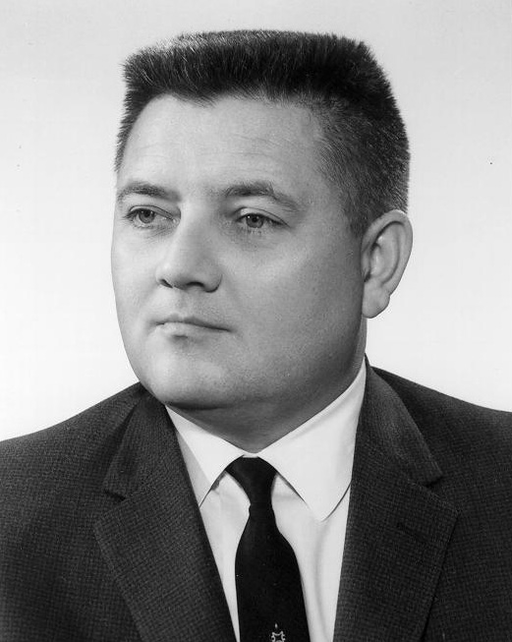
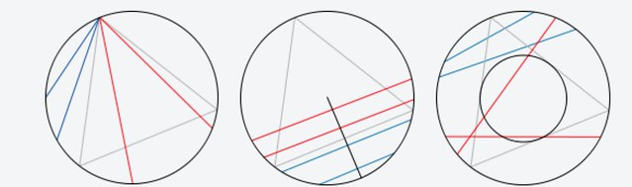
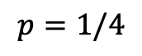
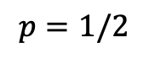
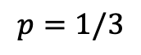
The Art of Picking Priors
$$p\left(x | y\right) = p\left(y | x\right) {⋅ \left[p\left(y\right)\right]}^{−1} ⋅ p(x)$$
marginalized likelihood
posterior
likelihood
prior
“.. every circumstance left unspecified in the statement of the problem defines an invariance property (i.e., a transformation to an equivalent problem) which that solution must have.”
-E.T. Jaynes, Prior Probabilities
$$p=1/3$$
$$p=1/2$$
$$p=1/4$$
Notes:
Content Slide Notes
“UNCLASSIFIED” marking of slides is not a security requirement and may be deleted from the Slide Master (View › Master › Slide Master). In general, slides should be marked “UNCLASSIFIED” if there is potential for confusion or misinterpretation of something that could be deemed classified. For guidance on marking slides containing classified and unclassified controlled information, see the Protecting Information Web site at http://int.lanl.gov/security/protectinfo/.

Slide 28
The Art of Picking Priors
$$p\left(x | y\right) = p\left(y | x\right) {⋅ \left[p\left(y\right)\right]}^{−1} ⋅ p(x)$$
marginalized likelihood
posterior
likelihood
prior
“.. every circumstance left unspecified in the statement of the problem defines an invariance property (i.e., a transformation to an equivalent problem) which that solution must have.”
-E.T. Jaynes, Prior Probabilities
*
$$p=1/3$$
$$p=1/2$$
$$p=1/4$$
Notes:
Content Slide Notes
“UNCLASSIFIED” marking of slides is not a security requirement and may be deleted from the Slide Master (View › Master › Slide Master). In general, slides should be marked “UNCLASSIFIED” if there is potential for confusion or misinterpretation of something that could be deemed classified. For guidance on marking slides containing classified and unclassified controlled information, see the Protecting Information Web site at http://int.lanl.gov/security/protectinfo/.

Slide 29
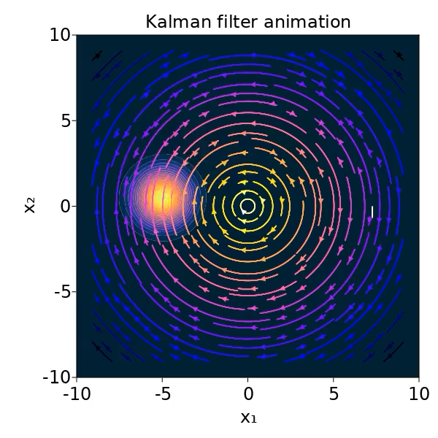
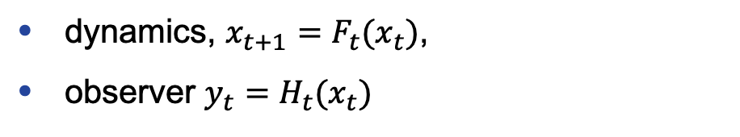
1st Flavor: State inference
$$p\left(x_{t} | y_{t}\right) = p\left(y_{t} | x_{t}\right) {⋅ \left[p\left(y_{t}\right)\right]}^{−1} ⋅ p(x_{t})$$
dynamics, $x_{t+1}=F_{t}(x_{t})$,
observer $y_{t}=H_{t}(x_{t})$
Notes:
Content Slide Notes
“UNCLASSIFIED” marking of slides is not a security requirement and may be deleted from the Slide Master (View › Master › Slide Master). In general, slides should be marked “UNCLASSIFIED” if there is potential for confusion or misinterpretation of something that could be deemed classified. For guidance on marking slides containing classified and unclassified controlled information, see the Protecting Information Web site at http://int.lanl.gov/security/protectinfo/.

Slide 30
1st Flavor: State inference
$$p\left(x_{t} | y_{t}\right) = p\left(y_{t} | x_{t}\right) {⋅ \left[p\left(y_{t}\right)\right]}^{−1} ⋅ p(x_{t})$$
dynamics, $x_{t+1}=F_{t}(x_{t})$,
observer $y_{t}=H_{t}(x_{t})$
Only a snapshot?
Notes:
Content Slide Notes
“UNCLASSIFIED” marking of slides is not a security requirement and may be deleted from the Slide Master (View › Master › Slide Master). In general, slides should be marked “UNCLASSIFIED” if there is potential for confusion or misinterpretation of something that could be deemed classified. For guidance on marking slides containing classified and unclassified controlled information, see the Protecting Information Web site at http://int.lanl.gov/security/protectinfo/.

Slide 31
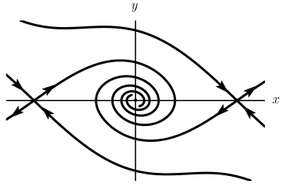

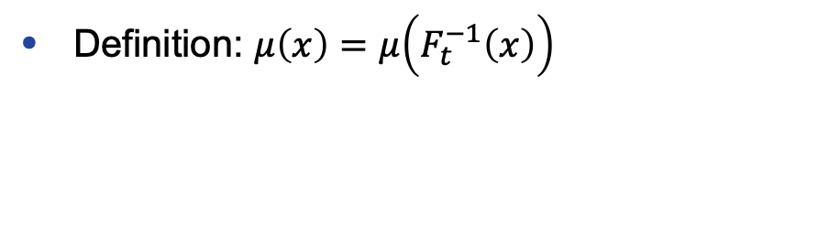
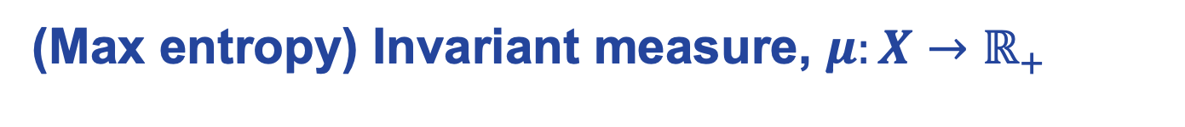
1st Flavor: State inference
$$p\left(x_{t} | y_{t}\right) = p\left(y_{t} | x_{t}\right) {⋅ \left[p\left(y_{t}\right)\right]}^{−1} ⋅ p(x_{t})$$
dynamics, $x_{t+1}=F_{t}(x_{t})$,
observer $y_{t}=H_{t}(x_{t})$
Only a snapshot?
(Max entropy) Invariant measure, $μ:X→ℝ_{+}$
Definition: $μ\left(x\right)=μ\left(F_{t}^{−1}\left(x\right)\right)$
Notes:
This is essentially what Gibbs assumed in setting up statistical mechanics; maximum entropy distribution.

Slide 32
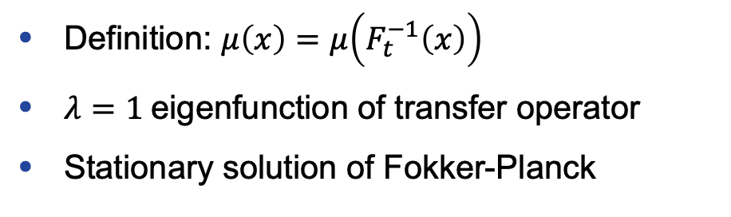
1st Flavor: State inference
$$p\left(x_{t} | y_{t}\right) = p\left(y_{t} | x_{t}\right) {⋅ \left[p\left(y_{t}\right)\right]}^{−1} ⋅ p(x_{t})$$
dynamics, $x_{t+1}=F_{t}(x_{t})$,
observer $y_{t}=H_{t}(x_{t})$
Only a snapshot?
(Max entropy) Invariant measure, $μ:X→ℝ_{+}$
Definition: $μ\left(x\right)=μ\left(F_{t}^{−1}\left(x\right)\right)$
$λ=1$eigenfunction of transfer operator
Stationary solution of Fokker-Planck
Notes:
Content Slide Notes
“UNCLASSIFIED” marking of slides is not a security requirement and may be deleted from the Slide Master (View › Master › Slide Master). In general, slides should be marked “UNCLASSIFIED” if there is potential for confusion or misinterpretation of something that could be deemed classified. For guidance on marking slides containing classified and unclassified controlled information, see the Protecting Information Web site at http://int.lanl.gov/security/protectinfo/.

Slide 33
1st Flavor: State inference
$$p\left(x_{t} | y_{t}\right) = p\left(y_{t} | x_{t}\right) {⋅ \left[p\left(y_{t}\right)\right]}^{−1} ⋅ p(x_{t})$$
dynamics, $x_{t+1}=F_{t}(x_{t})$,
observer $y_{t}=H_{t}(x_{t})$
Only a snapshot?
(Max entropy) Invariant measure
NNs!
Definition: $μ\left(x\right)=μ\left(F_{t}^{−1}\left(x\right)\right)$
$λ=1$eigenfunction of transfer operator
Stationary solution of Fokker-Planck
Wasserstein loss
DeepKoopman
Neural PDE
Notes:
Content Slide Notes
“UNCLASSIFIED” marking of slides is not a security requirement and may be deleted from the Slide Master (View › Master › Slide Master). In general, slides should be marked “UNCLASSIFIED” if there is potential for confusion or misinterpretation of something that could be deemed classified. For guidance on marking slides containing classified and unclassified controlled information, see the Protecting Information Web site at http://int.lanl.gov/security/protectinfo/.

Slide 34
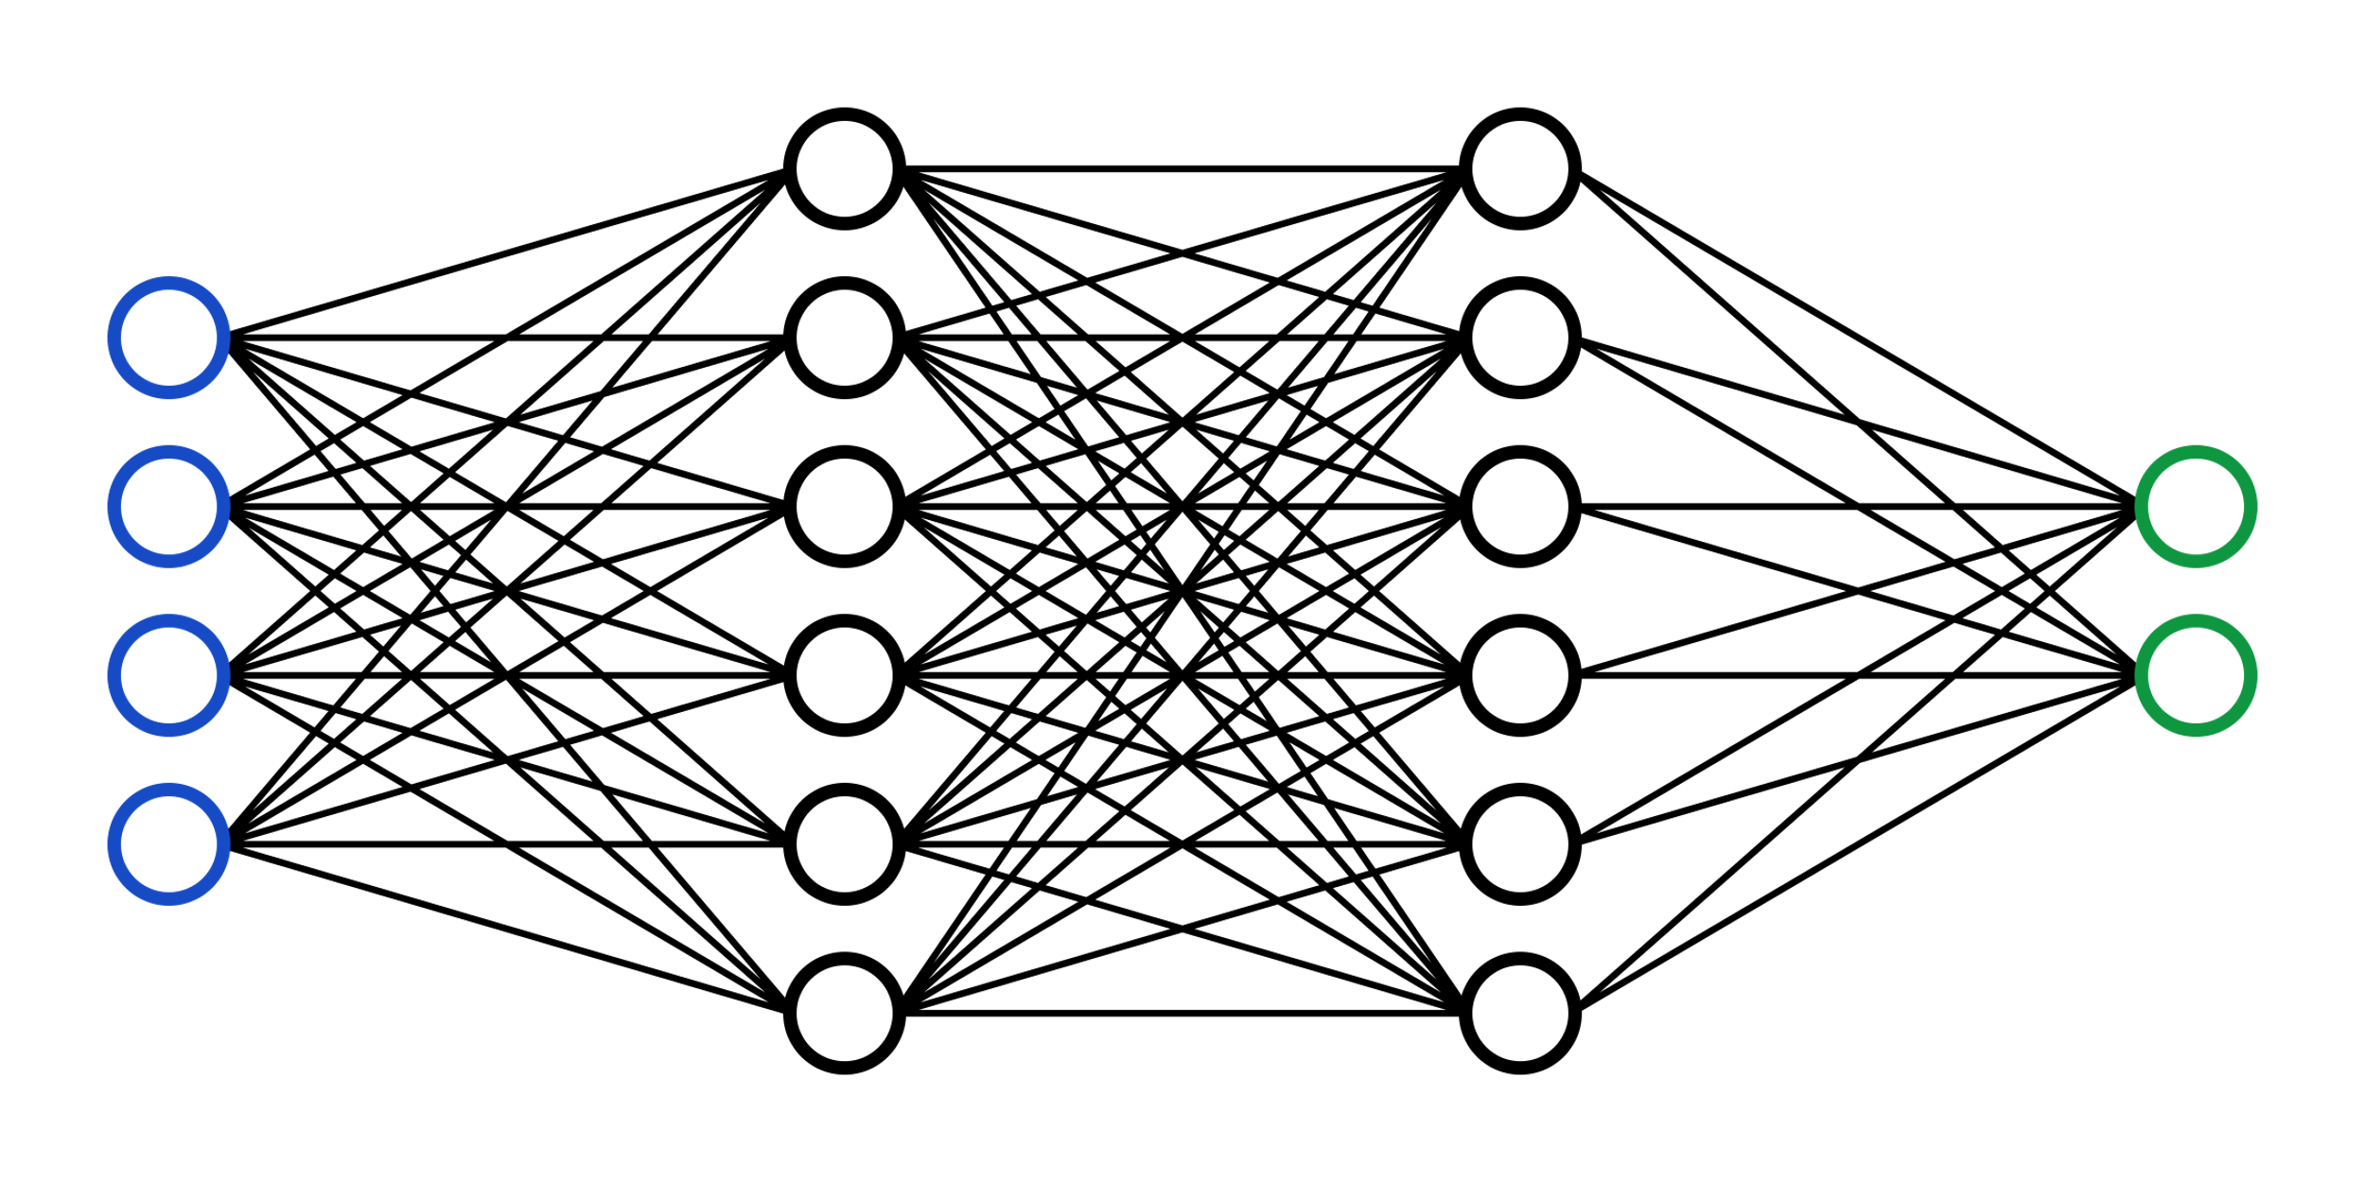
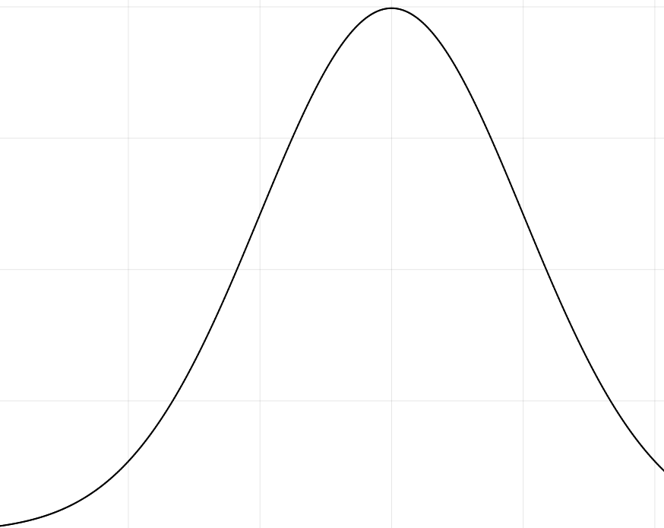
2nd Flavor: Model selection
$$p\left(w | 𝒟\right) = p\left(𝒟 | w\right) {⋅ \left[p\left(𝒟\right)\right]}^{−1} ⋅ p(w)$$
Train by inference rather than minimizing loss.
Gives a measure of confidence in model.
Notes:
Content Slide Notes
“UNCLASSIFIED” marking of slides is not a security requirement and may be deleted from the Slide Master (View › Master › Slide Master). In general, slides should be marked “UNCLASSIFIED” if there is potential for confusion or misinterpretation of something that could be deemed classified. For guidance on marking slides containing classified and unclassified controlled information, see the Protecting Information Web site at http://int.lanl.gov/security/protectinfo/.

Slide 35
2nd Flavor: Model selection
$$p\left(w | 𝒟\right) = p\left(𝒟 | w\right) {⋅ \left[p\left(𝒟\right)\right]}^{−1} ⋅ p(w)$$
Train by inference rather than minimizing loss.
Priors over:
Weight space - easy
or
Function space - interpretable
Gives a measure of confidence in model.
Notes:
If the NN is trying to make a relation between observation and state, a prior of invariant measure should be a statement of maximum ignorance about how y and x are related.

Slide 36
Project proposal
Modify Senseiver as Bayesian network
Test training by various inference techniques (MCMC, variational)
Impose dynamics-ignorant function-space prior
Learn invariant measure
DeepKoopman
Wasserstein loss
Optional: Modify the above to be Bayesian networks
Use invariant measure as prior to learn conditioning on observations (Senseiver)
Compare against dynamics-ignorant prior

